Slide 1
Itinerant topological magnons in Haldane Hubbard model with a nearly flat electronic band
Zhao-Long Gu

Slide 2
Contents
Background and motivation
Itinerant topological magnons on Haldane-Hubbard model

Slide 3
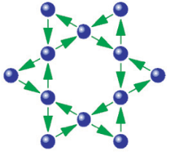


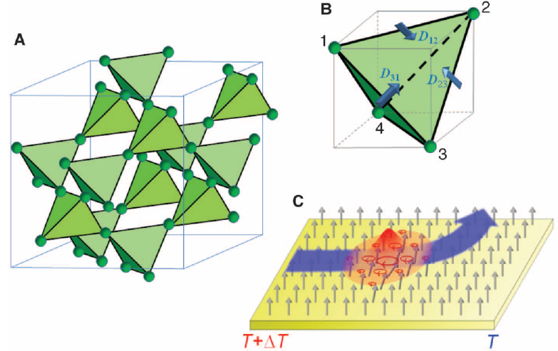
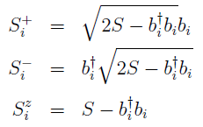
Background and motivation: topological magnons in local spin models
Hamiltonian:
On the Kagome layer:
HP transformation:
烧绿石结构
Linear spin wave Hamiltonian:
DM interaction acts as the vector potential of magnons
Y. Onose, T. Ideue, H. Katsura, Y. Shiomi, N. Nagaosa, Y. Tokura, Science 329, 297 (2010)
L. Zhang, J. Ren, J. –S. Wang, and B. Li, Phys. Rev. B 87, 144101 (2013)

Slide 4
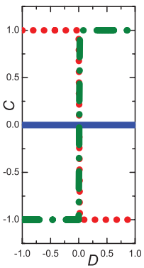
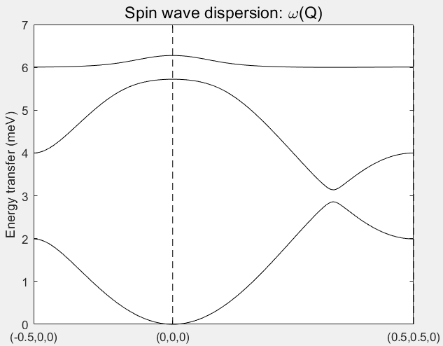
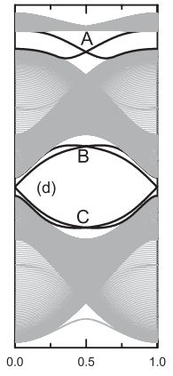
Background and motivation: topological magnons in local spin models
Linear spin wave Hamiltonian:
Y. Onose, T. Ideue, H. Katsura, Y. Shiomi, N. Nagaosa, Y. Tokura, Science 329, 297 (2010)
L. Zhang, J. Ren, J. –S. Wang, and B. Li, Phys. Rev. B 87, 144101 (2013)

Slide 5
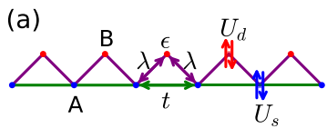

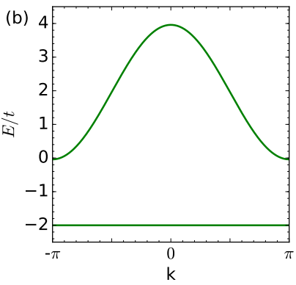



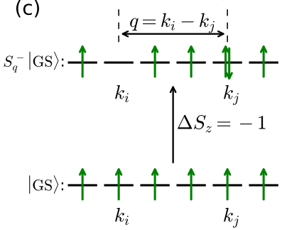
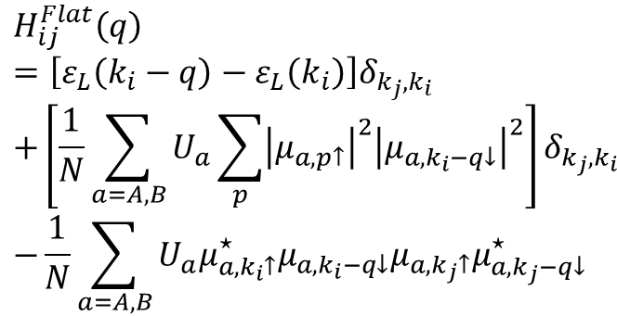

Background and motivation: itinerant topological magnons in one dimension
Hamiltonian:
A basis of spin-1 excitations intra the flat band
The matrix element of the Hamiltonian $H_{ij}^{Flat}\left(q\right)$ after the projection onto the flat band:
$$H_{ij}^{Flat}\left(q\right)$$
$$=\left[ε_{L}\left(k_{i}−q\right)−ε_{L}\left(k_{i}\right)\right]δ_{k_{j},k_{i}}$$
$$+\left[\frac{1}{N}\sum_{a=A,B}{U_{a}\sum_{p}{{\left|μ_{a,p↑}\right|}^{2}{\left|μ_{a,k_{i}−q↓}\right|}^{2}}}\right]δ_{k_{j},k_{i}}$$
$$−\frac{1}{N}\sum_{a=A,B}{U_{a}μ_{a,k_{i}↑}^{⋆}μ_{a{,k}_{i}−q↓}μ_{a,k_{j}↑}μ_{a,k_{j}−q↓}^{⋆}}$$
X. –F. Su, Z. –L. Gu, Z. –Y. Dong and J. –X. Li, Phys. Rev. B 97, 245111 (2018)

Slide 6
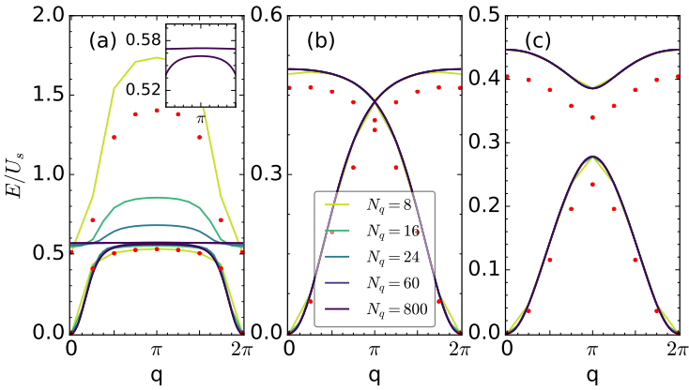
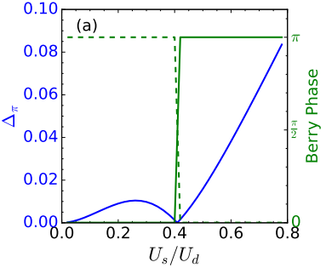
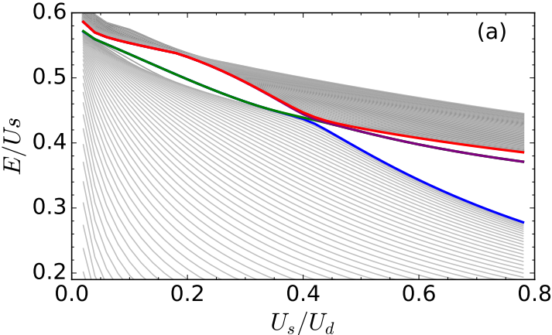
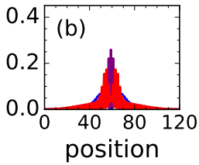
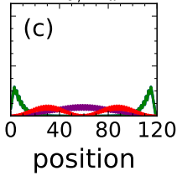
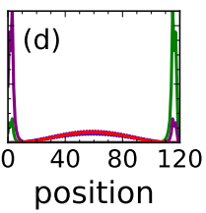
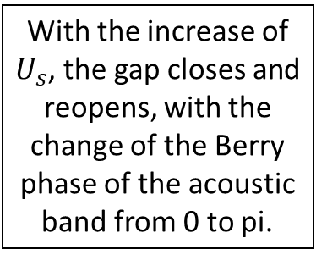
Background and motivation: itinerant topological magnons in one dimension
With the increase of $U_{s}$, the gap closes and reopens, with the change of the Berry phase of the acoustic band from 0 to pi.
After the topological transition, there always exists in-gap magnonic modes.
X. –F. Su, Z. –L. Gu, Z. –Y. Dong and J. –X. Li, Phys. Rev. B 97, 245111 (2018)

Slide 7

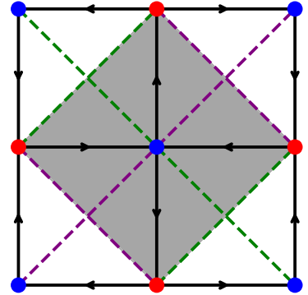



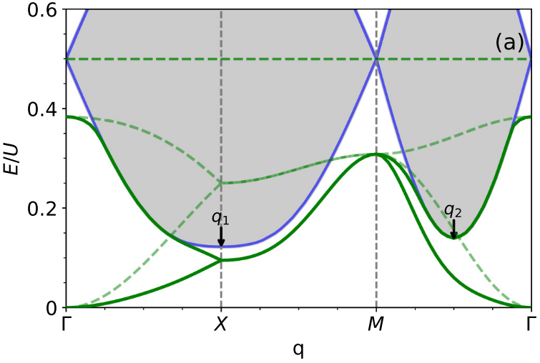
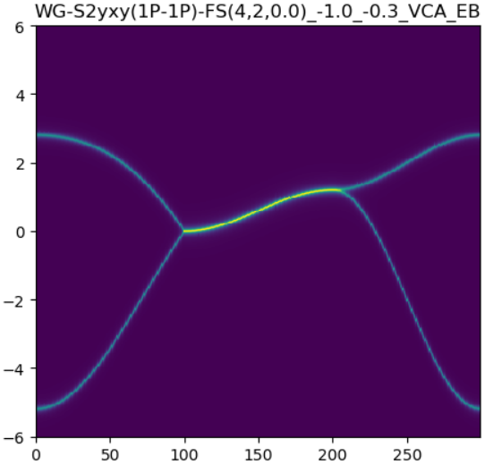
Background and motivation: itinerant magnons in a square lattice nearly flatband ferromagnet
Hamiltonian:
X. –F. Su, Z. –L. Gu, Z. –Y. Dong, S. –L. Yu, and J. –X. Li, Phys. Rev. B 99, 014407 (2019)

Slide 8
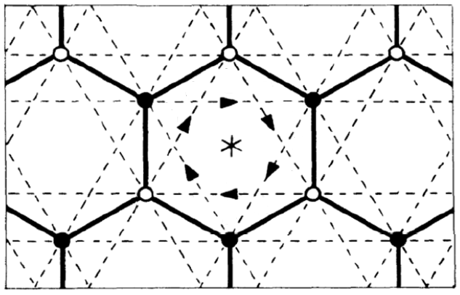

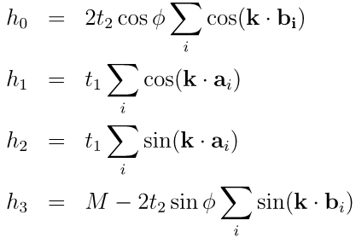
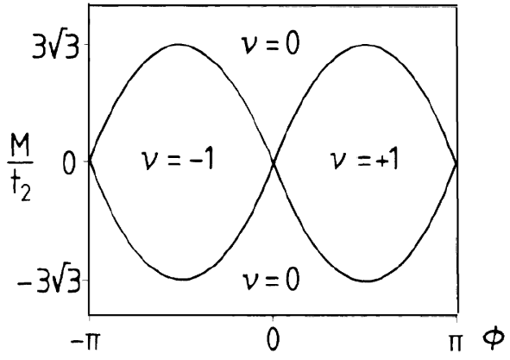

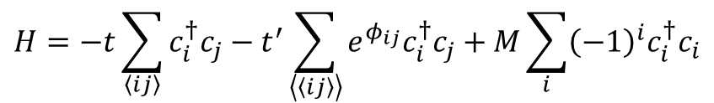


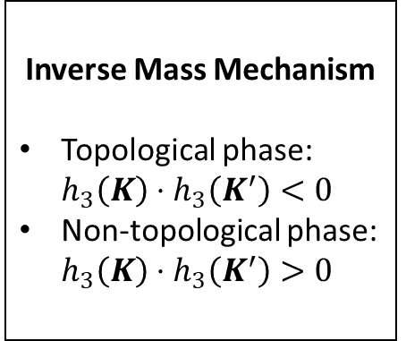
Itinerant topological magnons on Haldane-Hubbard model: introduction
Haldane model:
$$H=−t\sum_{\left\langle ij\right\rangle }{c_{i}^{†}c_{j}}−t^{′}\sum_{\left\langle \left\langle ij\right\rangle \right\rangle }{e^{φ_{ij}}c_{i}^{†}c_{j}}+M\sum_{i}{{\left(−1\right)}^{i}c_{i}^{†}c_{i}}$$
$$a_{2}$$
In the momentum space:
$$a_{3}$$
$$a_{1}$$
Experimental realization of Haldane model by fermionic cold atoms
where
Inverse Mass Mechanism
Topological phase: $h_{3}\left(K\right)⋅h_{3}\left(K^{′}\right)<0$
Non-topological phase: $h_{3}\left(K\right)⋅h_{3}\left(K^{′}\right)>0$
$$b_{1}=a_{2}−a_{3},b_{2}=a_{3}−a_{1}, b_{3}=a_{1}−a_{2}$$
F. D. M. Haldane, Phys. Rev. Lett. 61, 2015 (1988)
G. Jotzu, M. Messer, R. Desbuquois, M. Lebrat, T. Uehlinger, D. Greif and T. Esslinger, Nature 515, 237 (2014)

Slide 9
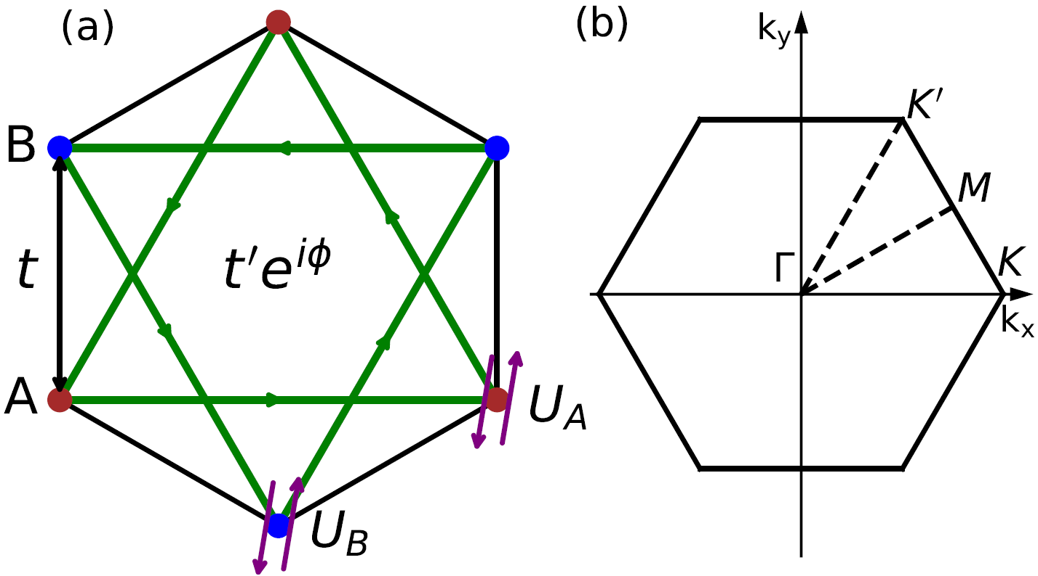
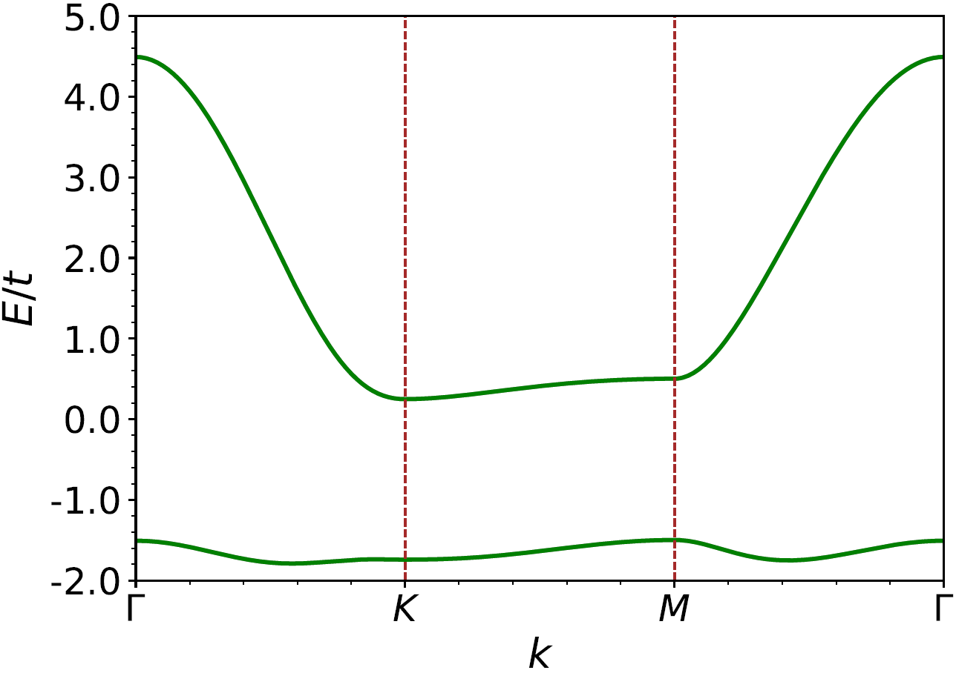
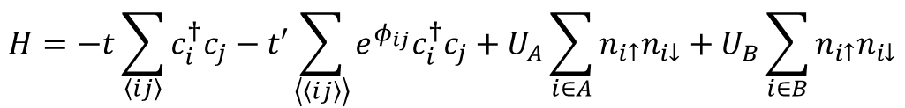
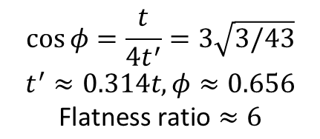
Itinerant topological magnons on Haldane-Hubbard model: introduction
Haldane Hubbard model with a nearly flat electronic band:
$$H=−t\sum_{\left\langle ij\right\rangle }{c_{i}^{†}c_{j}}−t′\sum_{\left\langle \left\langle ij\right\rangle \right\rangle }{e^{φ_{ij}}c_{i}^{†}c_{j}}+U_{A}\sum_{i∈A}{n_{i↑}n_{i↓}}+U_{B}\sum_{i∈B}{n_{i↑}n_{i↓}}$$
Electron band
$$\cos{φ=\frac{t}{4t^{′}}=3\sqrt{3/43}}$$
$$t^{′}≈0.314t,φ≈0.656$$
$$\text{Flatness} \text{ratio}≈6$$
The magnetism on such nearly flat band system has long been ignored.
T. Neupert, L. Santos, C. Chamon, and C. Mudry, Phys. Rev. Lett. 106, 236804 (2011)
Y. F. Wang, Z. C. Gu, C. D. Gong, and D. N. Sheng, Phys. Rev. Lett. 107, 146803 (2011)

Slide 10
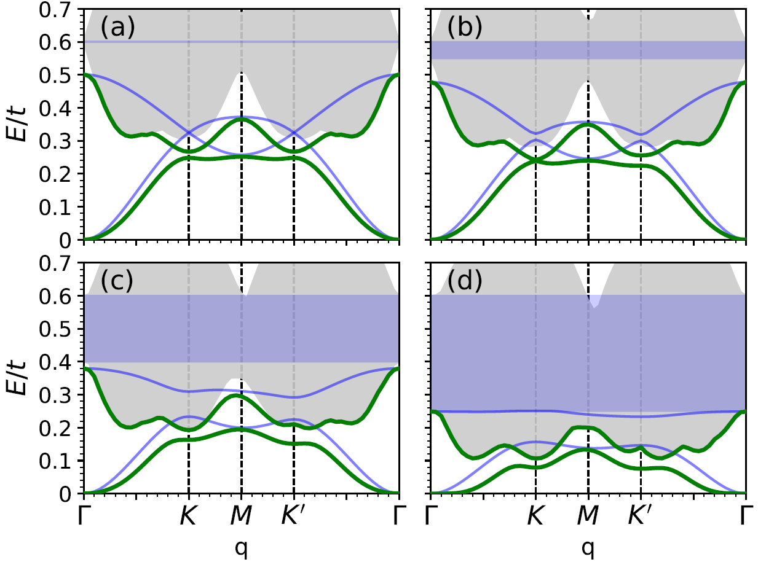
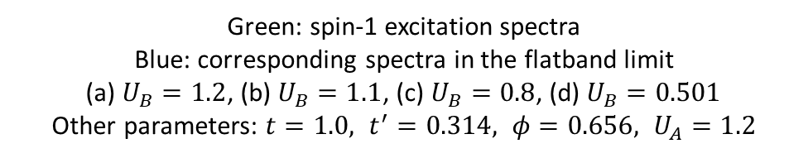
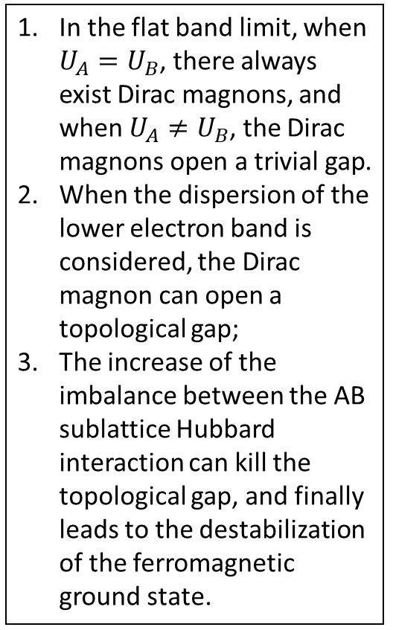
Itinerant topological magnons on Haldane-Hubbard model: numerical results
In the flat band limit, when $U_{A}=U_{B}$, there always exist Dirac magnons, and when $U_{A}≠U_{B}$, the Dirac magnons open a trivial gap.
When the dispersion of the lower electron band is considered, the Dirac magnon can open a topological gap;
The increase of the imbalance between the AB sublattice Hubbard interaction can kill the topological gap, and finally leads to the destabilization of the ferromagnetic ground state.
Green: spin-1 excitation spectra
Blue: corresponding spectra in the flatband limit
(a) $U_{B}=1.2$, (b) $U_{B}=1.1$, (c) $U_{B}=0.8$, (d) $U_{B}=0.501$
Other parameters: $t=1.0, t^{′}=0.314, φ=0.656, U_{A}=1.2$

Slide 11
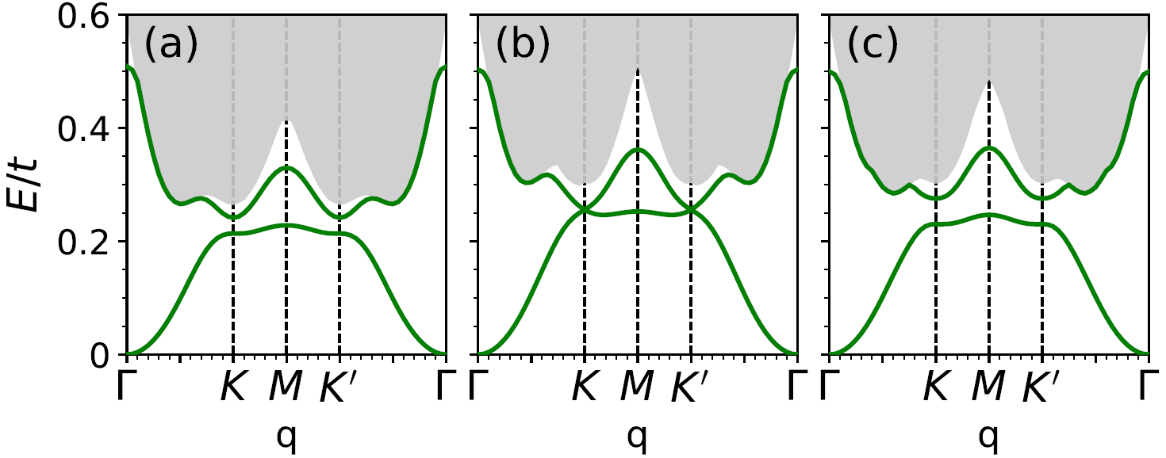
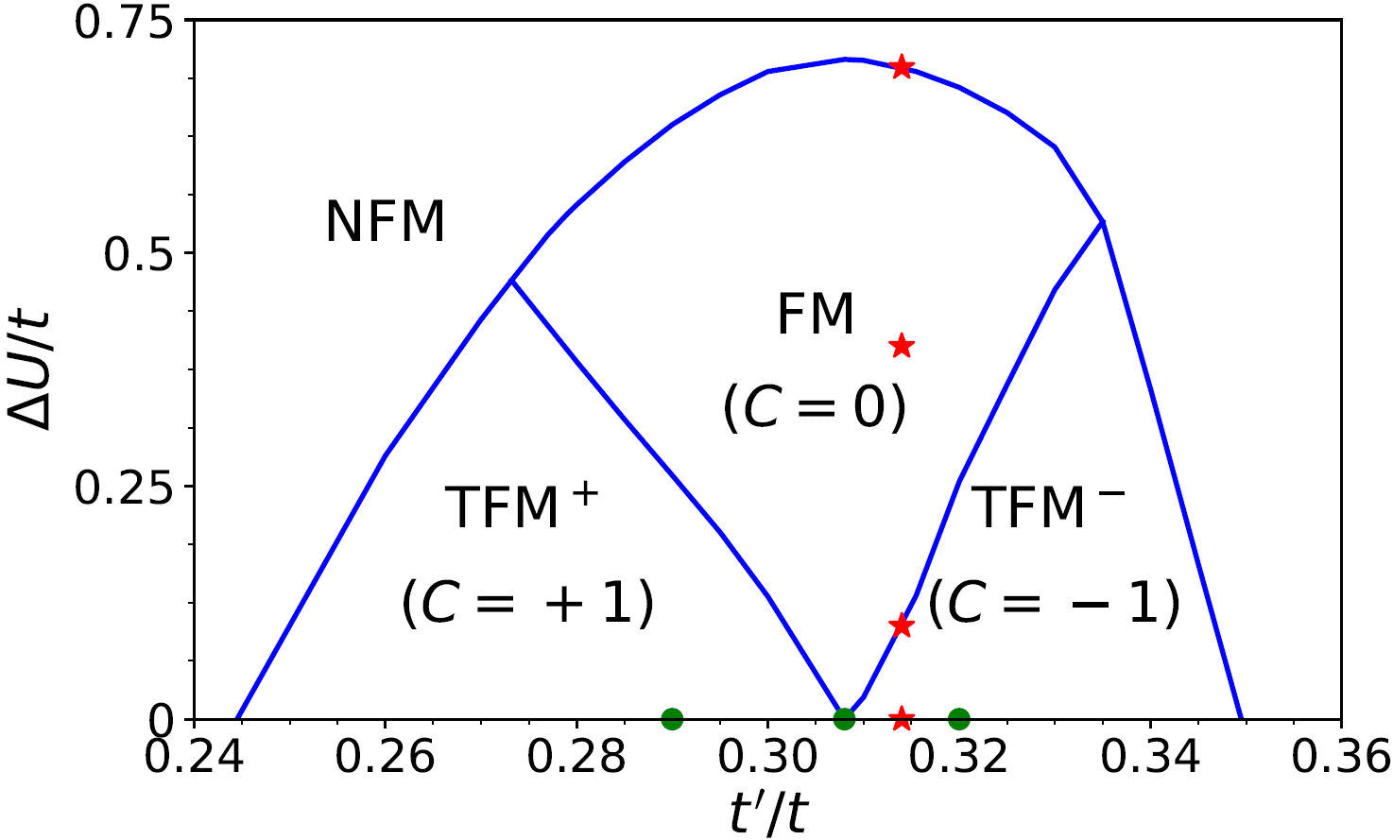

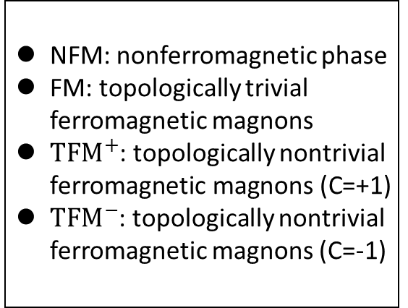


Itinerant topological magnons on Haldane-Hubbard model: numerical results
$$t^{′}=0.29$$
$$t^{′}=0.308$$
$$t^{′}=0.32$$
By tuning the nearest neighbor hopping amplitude, the topological gap can be closed and reopened, with the Chern number of the acoustic band changing its sign.
Other parameters: $t=1.0, φ=0.656, U_{A}=U_{B}=1.2$
NFM: nonferromagnetic phase
FM: topologically trivial ferromagnetic magnons
$TFM^{+}$: topologically nontrivial ferromagnetic magnons (C=+1)
$TFM^{−}$: topologically nontrivial ferromagnetic magnons (C=-1)

Slide 12
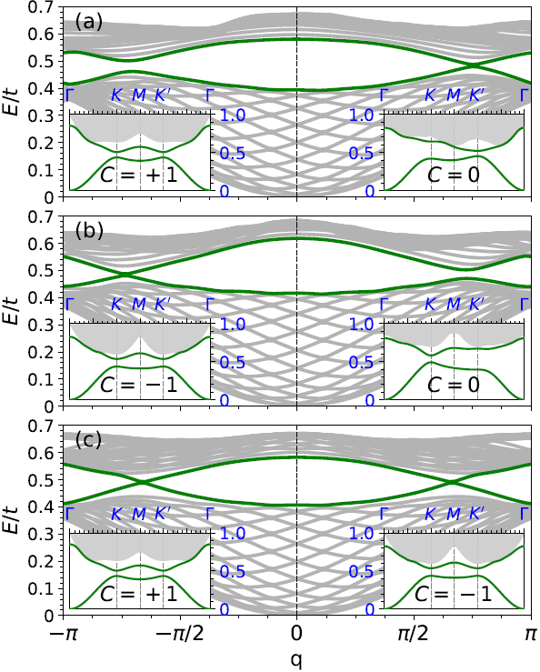
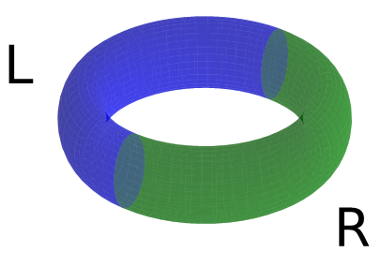
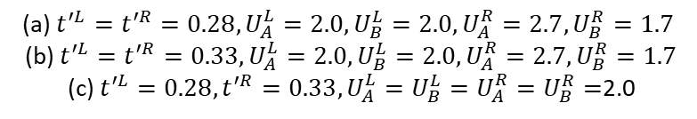

Itinerant topological magnons on Haldane-Hubbard model: numerical results
Domain wall geometry
Notes of edge states
Domain Wall geometry instead of open boundary;
Larger U for bigger gap;
Matched energy ranges of magnon bands.
Conclusion
On the domain walls between two topologically distinct phases, there always exist in-gap chiral magnonic modes, whose number equals the Chern number difference of the corresponding phases.
(a) $t^{′L}=t^{′R}=0.28, U_{A}^{L}=2.0,U_{B}^{L}=2.0,U_{A}^{R}=2.7,U_{B}^{R}=1.7$
(b) $t^{′L}=t^{′R}=0.33, U_{A}^{L}=2.0,U_{B}^{L}=2.0,U_{A}^{R}=2.7,U_{B}^{R}=1.7$
(c) $t^{′L}=0.28,t^{′R}=0.33, U_{A}^{L}=U_{B}^{L}=U_{A}^{R}=U_{B}^{R}=$2.0
Other parameters: $t=1.0, φ=0.656$

Slide 13
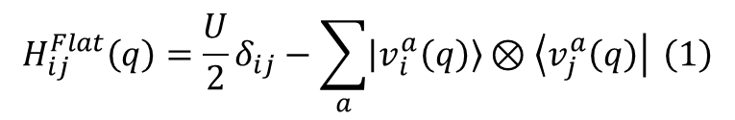


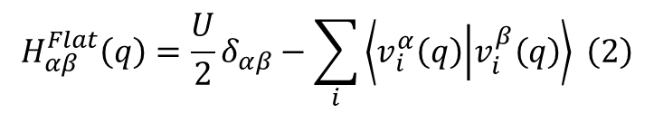
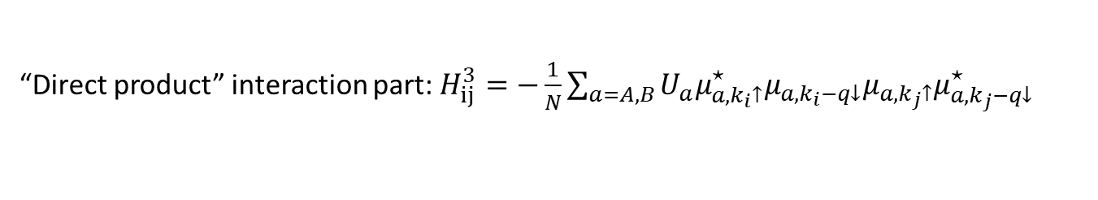
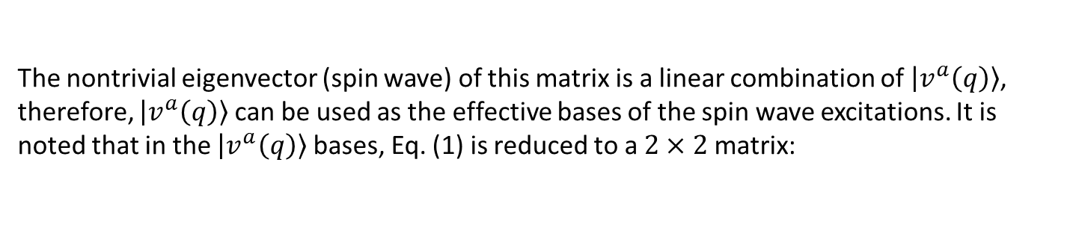
Itinerant topological magnons on Haldane-Hubbard model: inverse mass mechanism
Whole Hamiltonian: $H_{ij}^{Flat}\left(q\right)=H_{ij}^{1}+H_{ij}^{2}+H_{ij}^{3}$
Dispersion of electron band: $H_{ij}^{1}=\left[ε_{L}\left(k_{i}−q\right)−ε_{L}\left(k_{i}\right)\right]δ_{k_{j},k_{i}}$
Diagonal interaction part: $H_{ij}^{2}=\left[\frac{1}{N}\sum_{a=A,B}{U_{a}\sum_{p}{{\left|μ_{a,p↑}\right|}^{2}{\left|μ_{a,k_{i}−q↓}\right|}^{2}}}\right]δ_{k_{j},k_{i}}\underset{⇒}{U_{A}=U_{B}=U}\frac{U}{2}δ_{k_{j},k_{i}}$
“Direct product” interaction part: $H_{ij}^{3}=−\frac{1}{N}\sum_{a=A,B}{U_{a}μ_{a,k_{i}↑}^{⋆}μ_{a{,k}_{i}−q↓}μ_{a,k_{j}↑}μ_{a,k_{j}−q↓}^{⋆}}$
Define the “flatband particle-hole vector” of a sublattice as:
$\left|\left.v_{i}^{a}\left(q\right)\right\rangle \right.=$ $\sqrt{\frac{U_{a}}{N}}μ_{a,k_{i}↑}^{⋆}μ_{a{,k}_{i}−q↓}$
When $U_{A}=U_{B}=U$ and in the flatband limit:
$$H_{ij}^{Flat}\left(q\right)=\frac{U}{2}δ_{ij}−\sum_{a}{\left|\left.v_{i}^{a}\left(q\right)\right\rangle \right.⊗\left\langle \left.v_{j}^{a}\left(q\right)\right|\right.} \left(1\right)$$
The nontrivial eigenvector (spin wave) of this matrix is a linear combination of $\left|\left.v^{a}\left(q\right)\right\rangle \right.$, therefore, $\left|\left.v^{a}\left(q\right)\right\rangle \right.$can be used as the effective bases of the spin wave excitations. It is noted that in the $\left|\left.v^{a}\left(q\right)\right\rangle \right.$ bases, Eq. (1) is reduced to a $2×2$ matrix:
$$H_{αβ}^{Flat}\left(q\right)=\frac{U}{2}δ_{αβ}−\sum_{i}{\left\langle v_{i}^{α}\left(q\right) | v_{i}^{β}\left(q\right)\right\rangle } \left(2\right)$$

Slide 14
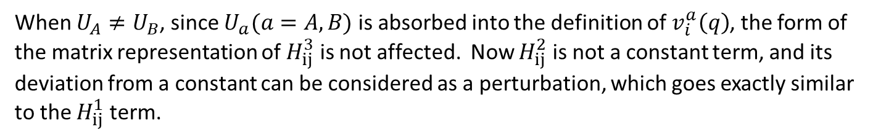
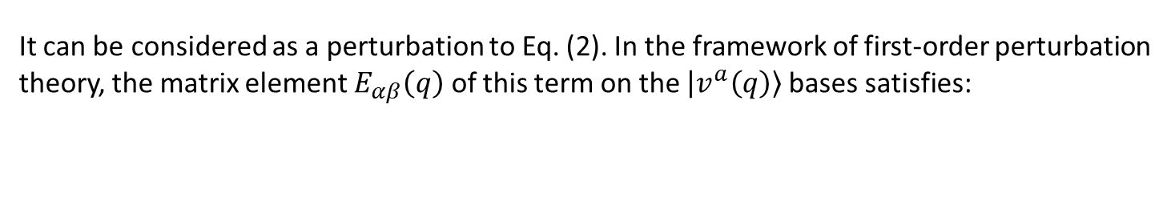


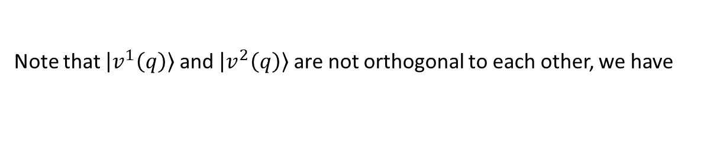
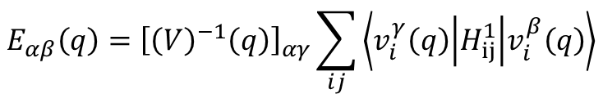
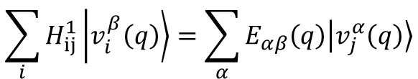
Itinerant topological magnons on Haldane-Hubbard model: inverse mass mechanism
Now let’s consider the dispersion of electron band:
$$H_{ij}^{1}=\left[ε_{L}\left(k_{i}−q\right)−ε_{L}\left(k_{i}\right)\right]δ_{k_{j},k_{i}}$$
It can be considered as a perturbation to Eq. (2). In the framework of first-order perturbation theory, the matrix element $E_{αβ}\left(q\right)$ of this term on the $\left|\left.v^{a}\left(q\right)\right\rangle \right.$bases satisfies:
$$\sum_{i}{H_{ij}^{1}\left|\left.v_{i}^{β}\left(q\right)\right\rangle \right.}=\sum_{α}{E_{αβ}\left(q\right)\left|\left.v_{j}^{α}\left(q\right)\right\rangle \right.}$$
Note that $\left|\left.v^{1}\left(q\right)\right\rangle \right.$ and $\left|\left.v^{2}\left(q\right)\right\rangle \right.$ are not orthogonal to each other, we have
$$E_{αβ}\left(q\right)={\left[{\left(V\right)}^{−1}\left(q\right)\right]}_{αγ}\sum_{ij}{\left\langle v_{i}^{γ}\left(q\right) | H_{ij}^{1} | v_{i}^{β}\left(q\right)\right\rangle }$$
Where $V_{αβ}\left(q\right)=\sum_{i}{\left\langle v_{i}^{α}\left(q\right) | v_{i}^{β}\left(q\right)\right\rangle }$.
When $U_{A}≠U_{B}$, since $U_{a}(a=A,B)$ is absorbed into the definition of $v_{i}^{a}\left(q\right)$, the form of the matrix representation of $H_{ij}^{3}$ is not affected. Now $H_{ij}^{2}$ is not a constant term, and its deviation from a constant can be considered as a perturbation, which goes exactly similar to the $H_{ij}^{1}$ term.

Slide 15
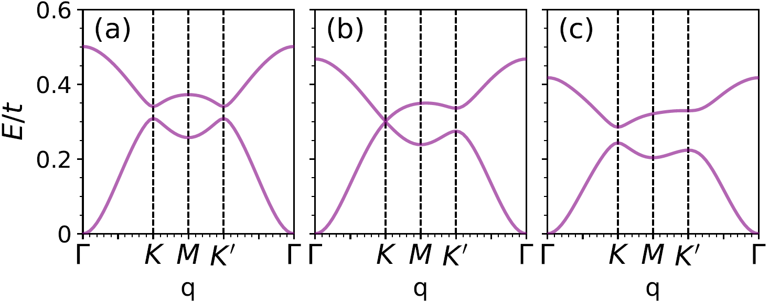
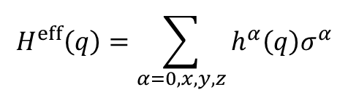
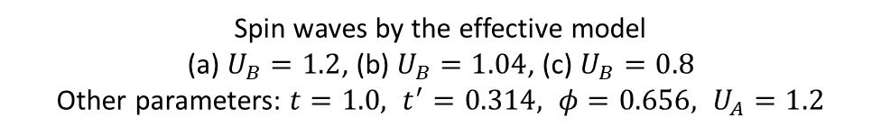

Itinerant topological magnons on Haldane-Hubbard model: inverse mass mechanism
With the above first-order perturbation theory, the effective Hamiltonian $H^{eff}\left(q\right)$ assumes the following form:
$$H^{eff}\left(q\right)=\sum_{α=0,x,y,z}{h^{α}\left(q\right)σ^{α}}$$
At $K/K^{′}$ point, it can be seen $h^{x}\left(q\right)$ and $h^{y}\left(q\right)$ are zero. Therefore, $h^{z}\left(q\right)σ^{z}$ can be viewed as the mass term of the Dirac magnon. When $ΔU≡U_{A}−U_{B}$ is small, we note that $h^{z}\left(K\right)$ and $h^{z}\left(K^{′}\right)$ have the opposite sign, meaning the gap is topological; whereas when $ΔU$ is large, $h^{z}\left(K\right)$ and $h^{z}\left(K^{′}\right)$ have the same sign, indicating that the gap is non-topological.
Spin waves by the effective model
(a) $U_{B}=1.2$, (b) $U_{B}=1.04$, (c) $U_{B}=0.8$
Other parameters: $t=1.0, t^{′}=0.314, φ=0.656, U_{A}=1.2$

Slide 16
Thank you for your attention!

